Slide 1
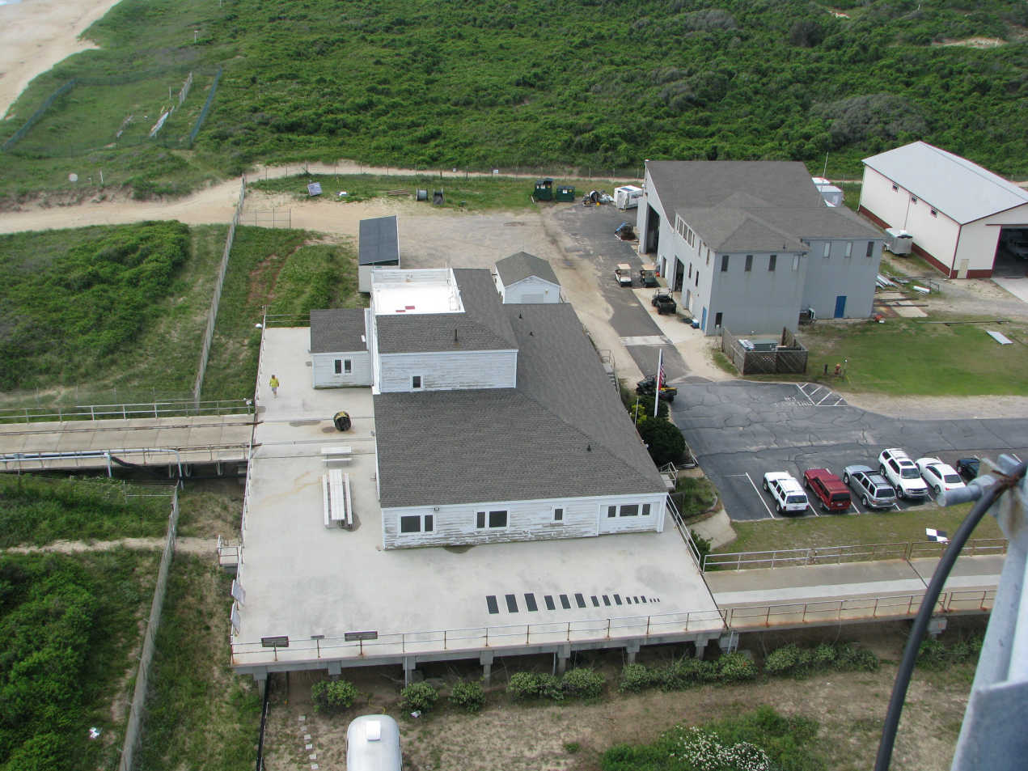
Units in cm
50
50
50
40
40
40
150
30
30
30
150
150
120
120
120
90
90
90
20
20
20
10
60
60
60
50
50
50
40
40
40
30
30
30
20
20
20
30
10
10

Slide 2
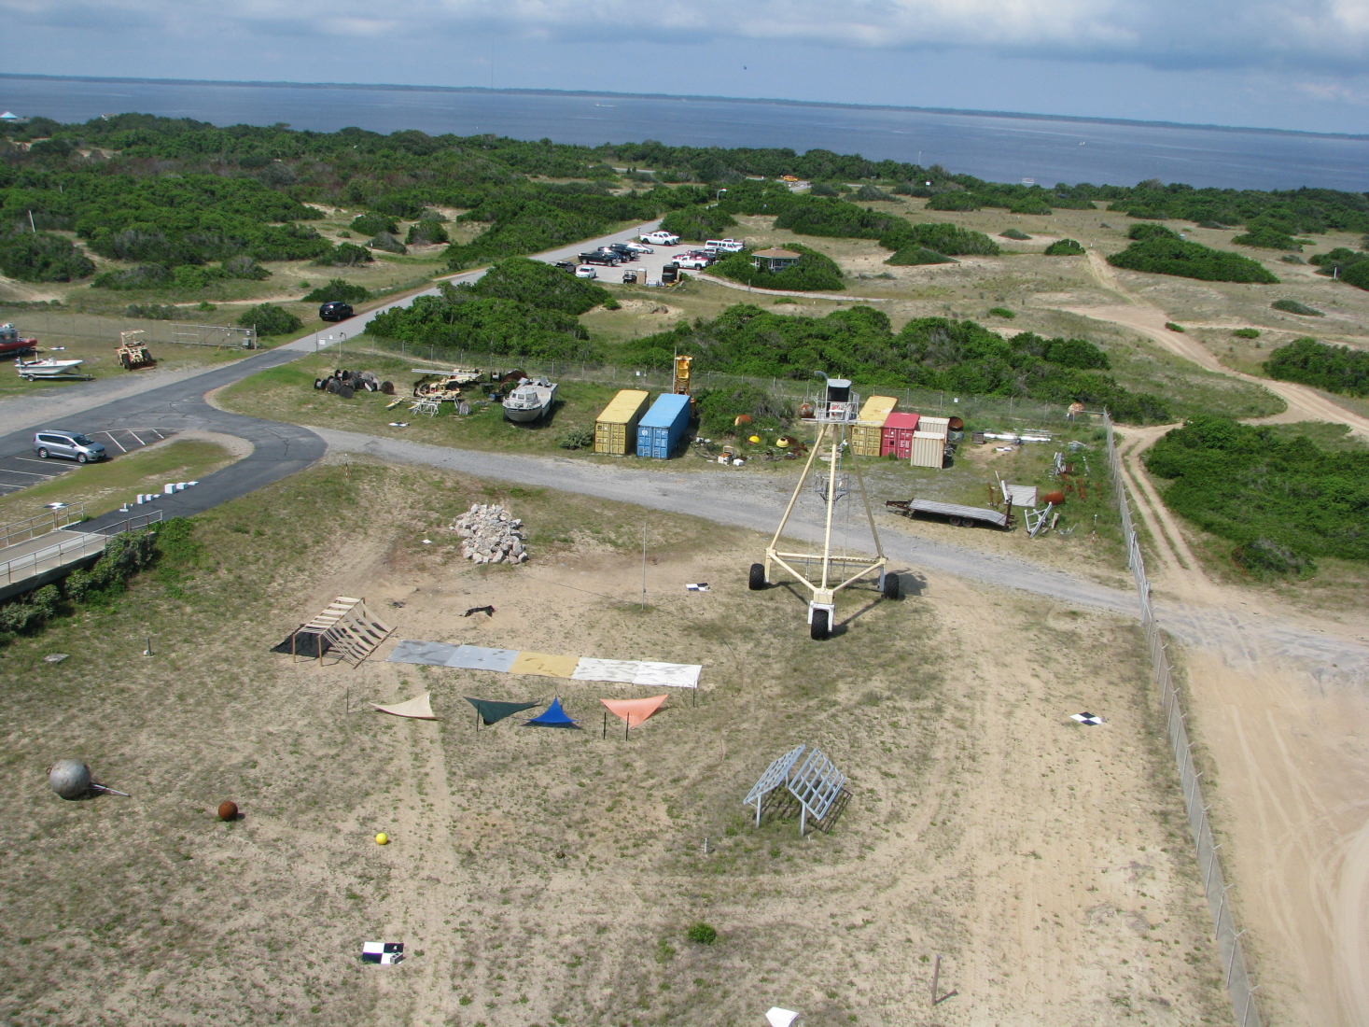
Max Circumference in Feet
15’3”
7’5”
2’9”
4’3”

Slide 3
In Feet
12’
12’
For All Colors
12’

Slide 4
In meters
3
3
3
3
3
3
3

Slide 5
In cm
10 10 10
30 30 30
50 50 50
10 10
30 30 30
50 50 50

Slide 6
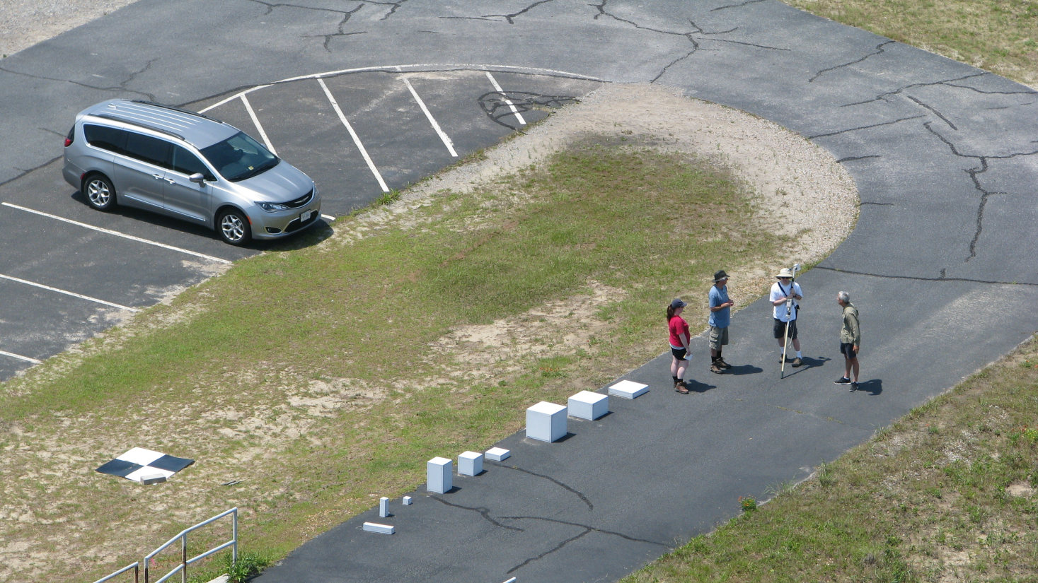
H
I
G
E
F
D
B
C
A
Blocks are square (Width = Length)
Block | Height [m] | Width [m]
A | 0.5 | 0.1
B | 0.3 | 0.1
C | 0.1 | 0.1
D | 0.5 | 0.3
E | 0.3 | 0.3
F | 0.1 | 0.3
G | 0.5 | 0.3
H | 0.3 | 0.3
I | 0.1 | 0.5

